Slide 1
#04 File I/O, Object Streams and Exceptions
Notes:
Give an explanation for file I/O, object streams and exceptions
Relevant theoretical decisions
What is the purpose of data files and how is it used in a C# program?
Name some common file types used for storing data
How can you store and load objects on files?
What is exception handling?
Is it necessary to handle exceptions in a C# program?
What is the difference of caught and uncaught exception?
How can exception in a C# program be handled?

Slide 2
File I/O
Why are files needed?
Usage of files
Common file types
Notes:
Files are a necessity when data needs to be saved, because of either moving of data or storage of data when a program is closed.
A stream is a sequence of bytes that flow from a source to a destination
In a program, we read information from an input stream and write information to an output stream
A program can manage multiple streams simultaneously
Example of a stream are Console.In , Console.Out , Console.Error
Common or known file types/extensions, are i.e. .txt a file that is formatted for viewing in a typical text editor, that it’s using som known encoding formats such as ansi.

Slide 3
File I/O Example
private void Run( )
{ // open a file
FileInfo theSourceFile = new FileInfo(
@"C:\test\source\test.cs");
// create a text reader for that file
StreamReader reader = theSourceFile.OpenText( );
// create a text writer to the new file
StreamWriter writer = new StreamWriter(
@"C:\test\source\test.bak", false);
// create a text variable to hold each line
string text;
// walk the file and read every line
// writing both to the console
// and to the file
do
{
text = reader.ReadLine( );
writer.WriteLine(text);
Console.WriteLine(text);
}while (text != null);
// tidy up
reader.Close( );
writer.Close( );
}
Notes:
When this program is run, the contents of the original file are written both to the
screen and to the new file. Notice the syntax for writing to the console:
Console.WriteLine(text);
This syntax is nearly identical to that used to write to the file:
writer.WriteLine(text);
The key difference is that the WriteLine( ) method of Console is static, and the
WriteLine( ) method of StreamWriter, which is inherited from TextWriter, is an
instance method, and thus must be called on an object rather than on the class itself.

Slide 4
Object Streams
Why do we want to store or load objects
Serialization when working with objects
Using a Formatter
Notes:
Saving and loading an object is very handy when you need to load or store an objects state. This used in chat programs over the internet. It is also used in games when you save you state in the game. Is also used when objects are stored in a database.
When an object is streamed to disk, its various member data must be serialized, that is, written out to the stream as a series of bytes.
In any case, the code reading the data expects that data to be in a particular format. Most of the time in a .NET application,
the expected format is the native binary format or SOAP. SOAP is a simple, lightweight, XML-based protocol for exchanging
information across the Web.
When data is serialized, the format of the serialization is determined by the formatter
you apply. SoapFormatter for use with web services and a BinaryFormatter
that is useful for fast local storage or remoting.

Slide 5
Object Streams Example
using System.IO;
using System.Runtime.Serialization.Formatters.Binary;
namespace ObjectStreamTest
{
[Serializable]
public class ObjectStream
{
static public void Save(object data)
{
FileStream file = new FileStream("store.bin", FileMode.Create);
BinaryFormatter formatter = new BinaryFormatter();
formatter.Serialize(file, data);
file.Close();
}
static public object Load()
{
FileStream file = new FileStream("store.bin", FileMode.OpenOrCreate);
object data = null;
if (file.Length != 0)
{
BinaryFormatter formatter = new BinaryFormatter();
data = formatter.Deserialize(file);
}
file.Close();
return data;
}
}
}
Notes:
Example taken from Marius slide 10A, but there is a missing [Serializable] in the example!

Slide 6
Exceptions
What is exceptions
Exception handler
Try block
Throw exceptions
Catch exceptions
Notes:
Exceptions handles abnormal conditions. An exception is an object that encapsulates information about an unusual program occurrence.
Exceptions aren’t a protection against user programmed bugs. A bug might cause an exception.
Errors are caused by user action. i.e. a user types in a number where a letter is expected. An error might cause an exception.
Some things causes an exception that is not a bug nor an error, such as running out of memory.
The exception handler is a block of code designed to handle the exception.
try block is a block where you throw exceptions in.
throw keyword are used when you need to throw an exception, i.e. if you think your application has done something abnormal. It can be used when you’re debbugging. Example: throw new System.IO.IOException()
catch is used to handle the thrown exception is also used together with the try. Best practice is to specify which exception the catch should take care of!!!

Slide 7
File I/O and Exceptions Example
using System;
using System.IO;
class Test
{
public static void Main()
{
try
{ // Create an instance of StreamReader to read from a file.
// The using statement also closes the StreamReader.
using(StreamReader sr = new StreamReader("TestFile.txt"))
{
String line; // Read and display lines from the file until the end of the file is reached.
while ((line = sr.ReadLine()) != null)
{
Console.WriteLine(line);
}
}
}
catch (Exception e)
{ // Let the user know what went wrong.
Console.WriteLine("The file could not be read:"); Console.WriteLine(e.Message);
}
}
}

Slide 8
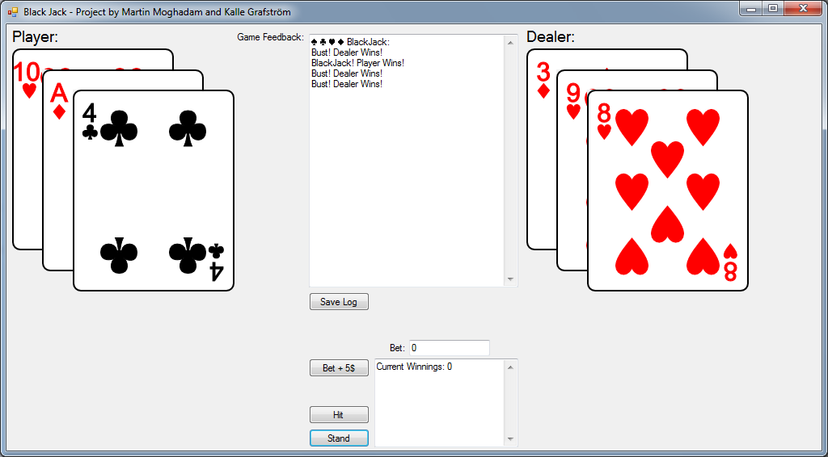
Use in our program
Black Jack Game
Log
Save Log
Betting
Hit
Stand

Slide 9
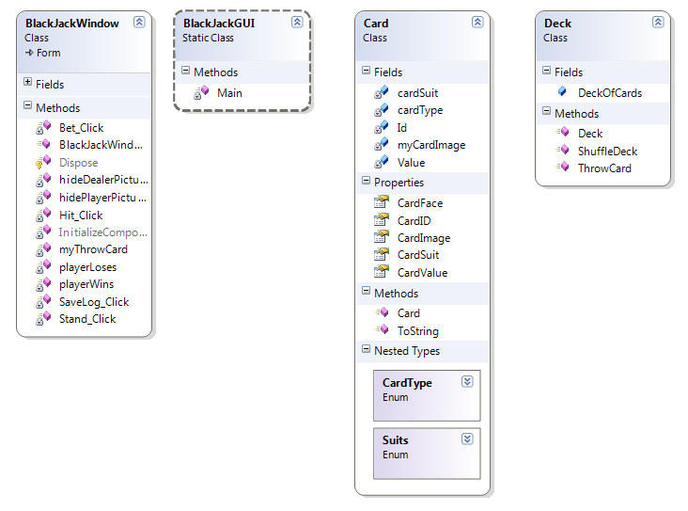
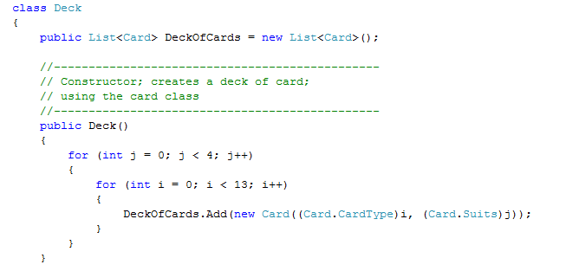
Use in our program
List and foreach in our application
Notes:
Our application uses list to contain the cards and the foreach statement to manage the cards
Our application contains a simple card class, and a deck class.
A deck of cards is a list that contains objects of the type card.

